Slide 1

PARAMETERIZED DNN DESIGN FOR IDENTIFYING THE RESOURCE LIMITATIONS OF EDGE DEEP LEARNING HARDWARE
Project ID | PSCSE22-0071
Student Name | Shin Thant Aung
Supervisor | A/P Liu Weichen
Examiner | Dr Smitha K G
1
Notes:
Good Evening, Professors.
Thank you for attending my presentation. My name is Shin and today I’ll be presenting about my Final Year Project..

Slide 2
Overview
02
04
01
03
05
Methodologies
Experiments
Introduction
Implementation
Conclusion & Future Works
2
Notes:
The content I’ll be covering today are as follows:
Introduction which includes background and objectives of the project.
Methodologies that I implemented along this project.
Followed by detailed Implementation
Then, I’ll present about the experiments I conducted.
Finally, I’ll conclude this project with the future improvements.

Slide 3
01 Introduction
3

Slide 4
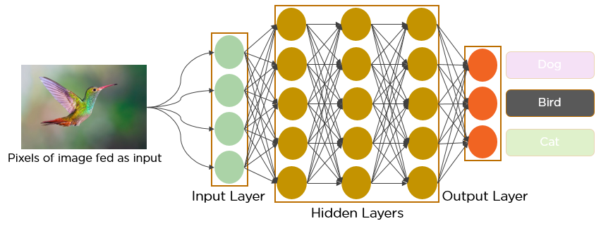
01 Introduction: Background
DNN
DNN
Cloud
Deep Neural Networks (DNN)
Inspired by structure and function of human brain
High computational cost
Cloud Computing
Equipped with high computational power E.g.: Graphical Processing Unit (GPU)
Computation takes place at cloud server
Suffers from network latency
Layer
Neuron
Computation takes place here
GPU
Autonomous Car
Cell Phone
IOT Devices
Edge Devices
4
Notes:
Deep Neural Network is a subset of machine learning algorithms inspired by the structure and function of human brains.
It consists of interconnected nodes called neurons, organized in layers. Each layer processes information, passes it to the next layer to learn the complex patterns in data.
Eventually, the network can solve the specific task using the given data.
In today world, DNNs are widely used in image processing such recognizing images and object detection.
DNN usually contains many layers and billions of neurons, that makes it requires high computational power to process data.
In practice, DNNs are usually deployed on systems equipped with high computational resources such as cloud servers.
So that, DNN can process the data in a short time.
However, cloud computing comes with several drawbacks such as network latency,
i.e.: the time that data travel from the edge device to the cloud and back.
It’s a nightmare for the real-time Edge applications such as autonomous cars..

Slide 5


01 Introduction: Background
Cloud
Edge Computing
Computation takes place at edge devices
Edge Devices are designed for resource-constraints environments.
Equipped with lower computational power E.g.: Embedded GPU, System on Chip(SoC)
Memory Limitations
Limited Processing Power
Energy Constraints
Heat Dissipation
DNN
Resource Limitations
Memory
Ceiling
Limited Processing Power
Energy Constraints
Computation takes place here
Autonomous Car
Cell Phone
IOT Devices
Edge Devices
5
Notes:
So, Industries trying to use the DNNs directly on the edge devices for real-time applications such as autonomous cars and IOT applications.
Unlike cloud server, Edge devices are usually small, compact and designed for resource-constraint environments. and equipped with low computational power.
That’s why, edge devices has many resource constraints such as memory limitations, limited processing power, Energy Constraints and Heat Dissipation Issue.

Slide 6
01 Introduction: Objectives
Measure Resource Requirements & Limitations
Implement Model Compression Technique to Finetune DNN
Compare Performance & Resource Requirements
6
Notes:
So, the first objective of this project is to develop a tool to measure the resource requirements of a DNN and limitations of a particular Edge device.
2nd goal is to Implement the model compression technique to minimize resource requirements without sacrificing much performance.
So that, model can be deployed on edge devices.
The final goal is to compare performance and resource requirements of base and compressed models.
So that, we can gain insight how much tradeoff we need between model performance and resource requirements.

Slide 7
02 Methodologies
7

Slide 8
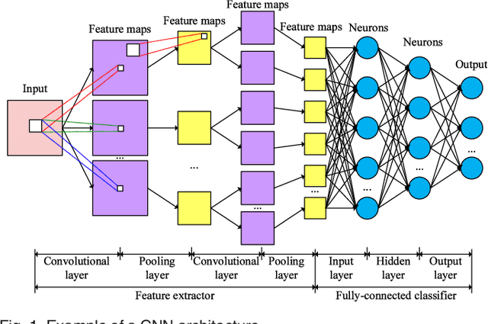
02 Methodologies: Deep Neural Network (DNN)
Convolution Neural Network (CNN)
Consists of feature maps and neuron layers
Layer Wise Parallel Computation
8
Notes:
Convolution Neural Network is a type of DNN widely used in image processing such as image classification and object detection.
It consists of many feature maps that extract significant patterns in the input image, then these patterns are passed to neuron layers to learn to classify the objects in the input image.
Key point to note is that feature maps and neurons in each layer are independent to each other and can carry out their tasks concurrently.
References:
https://www.analyticsvidhya.com/blog/2022/01/convolutional-neural-network-an-overview/

Slide 9
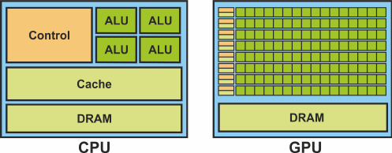
02 Methodologies: Deep Learning Hardware
GPUs - Graphical Processing Units
Specially designed for parallel computations.
Large number of processor cores makes its ideal for throughput computing and data parallelism.
CPUs - Central Processing Units
Designed for a wide variety of applications and to provide fast response times to a single task.
Limited number of processor cores limits how many pieces of data can be processed simultaneously.
9
Notes:
CPU is Central Processing Units and traditional processors commonly found in almost every computing devices.
<Read slides>
That’s why, it’s not appropriate to infer DNN which needs layer wise parallel computation.
To facilitate the need of parallel computation, special hardware called deep learning hardware are required.
Deep learning hardware usually contains a devices that can facilitate parallelism such as graphical processing units (GPU).
<read slides line 2>
GPU is widely used for DNN application today due to its parallel processing power.
References:
https://www.google.com/url?sa=i&url=https%3A%2F%2Fwww.linkedin.com%2Fpulse%2Fcpu-vs-gpu-tpu-when-use-your-machine-learning-models-bhavesh-kapil&psig=AOvVaw3kYo_iF2DLzE_0HoZWEm4v&ust=1714208883779000&source=images&cd=vfe&opi=89978449&ved=0CBQQjhxqFwoTCKCMlPXD34UDFQAAAAAdAAAAABAZ

Slide 10



02 Methodologies: Performance Metrics
How do we know whether a DNN is suitable for inference on an Edge Device?
Power Usage
Latency: time taken for a single inference
Throughput: number of inferences done per unit of time
Top1 Accuracy: % of correct predictions with the highest probability
Top5 Accuracy: % of correct predictions among top 5 highest probability
Measured in Kilo-Watt Hour (kWh)
The amount of energy consumed when 1kW of power is used for 1 hour
Amount of memory consumed during runtime
Inference Speed
Accuracy
Memory
10
Notes:
To understand that, the metrics are required to measure how much resources a DNN need during the inference and it’s performance.
Edge Devices have limited energy, so, it’s very important to measure how much energy is consumed during the DNN inference.
<readslides>
2ndly, inference speed is crucial in real time applications.
Inference speed can be measured in 2 metrics, latency that measures how long the device takes to process a single data input
Throughput measures how many data inputs can be processed in a unit of time
3rdly, Accuracy is a common metric to measure how well a DNN can perform on a specific task.
Accuracy can be measured simply by counting how many images a DNN can recognize correctly in image recognition.
The last matric is the memory consumption that measures how much memory is required while running DNN.

Slide 11


02 Methodologies: Hyperparameters
What are the Hyperparameters affecting the performance of DNN?
Computational Complexity
Measured in Pixels
2-Dimensional Space (Height x Width)
Measured in Number of Input Images at one time
Measured in Floating Point Operations (FLOPs)
Number of floating-point arithmetic calculations
Input Size
Batch Size
11
Notes:
What are the factors that can affect the performance of DNN?
First, computational complexity is usually measured in FLOPs <readslides>
FLOPs is how much computation power that a DNN needs to complete the task on given data.
The larger the FLOPs, the more computational power the model requires.
2ndly, the input size, i.e: the width and height of input images in image processing.
Larger input image requires more computations and times to process.
Lastly, The batch size which is the number of input instances given to the DNN at a single inference.

Slide 12

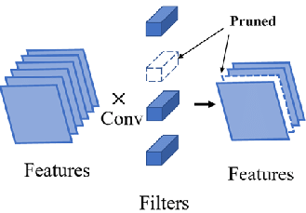
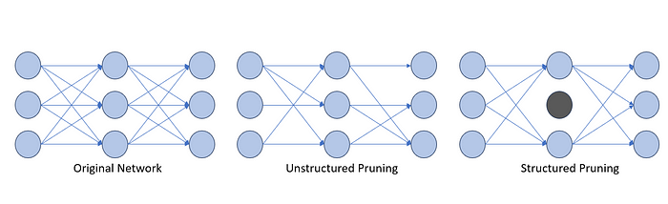

02 Methodologies: Model Compression
Structural Pruning
Calculate how much important each component is
Eliminate least important components in the network
12
Notes:
In most cases, base DNN could be consuming too much hardware resources regardless of input size and batch size.
In that case, we want to reduce the resource consumption by adjusting model computational complexity using pruning methods.
There are several pruning methods available, one of the popular method is structural pruning
Structural pruning can be done in 2 simple steps, <readslides> such as neurons and feature maps
References:
https://medium.com/@goyal.ayush55/pruning-neural-networks-1f3a3be79c7d
https://www.researchgate.net/publication/348369008/figure/fig2/AS:1021554842402817@1620569062900/The-schematic-illustration-of-two-types-of-network-pruning-methods-according-to.png

Slide 13

02 Methodologies: DepGraph Algorithm
Parameters from different layers are dependent each other.
Conv 1
Batch Norm 1
DepGraph Algorithm
Analyzes dependency between layers and builds Dependency Graph
Automatically adjust dependent layers according to the dependency
ReLU
Conv 2
Batch Norm 2
ReLU
13
Notes:
But removing an unimportant component could result bad model performance because parameters from different layers are dependent each other.
For example, in the neural network on the right side, let’s say we want to remove conv2 layer, then we have to adjust other dependent layers as well.
So that, we need an algorithm that can seamlessly remove component without affecting much performance.
DepGrpah is an algorithm that can <read slide>
References:
https://medium.com/@goyal.ayush55/pruning-neural-networks-1f3a3be79c7d

Slide 14
03 Implementation
14

Slide 15
03 Implementation: Workflow
15
Notes:
This is the overview of the project workflow.
Profiler – to measure resource requirements on the edge device.
Evaluator – that evaluate model performance, i.e. accuracy, on the benchmark dataset
Model Compression – performs model compression using DepGraph algorithm
Firstly, we have DNN model called model.pt and we used the hyperparameters such as input shape and batch size to create tensor input.
Then, feed the input data to the model on the edge device and the profiler will measure performance metrics.
Evaluator evaluates the accuracy separately on a device with high performance GPU to facilitate fast processing.
Model can be compressed separately to determine how much we can reduce the resource requirements by fine tuning model complexity called FLOPs.

Slide 16


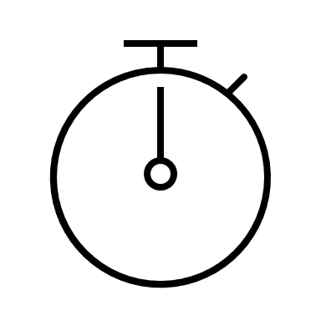


03 Implementation: Libraries Used
Dataset
Torch Profiler
Memory Footprint
Inference Time
PyTorch
Pretrained DNNs
Torch Profiler
Model Compression
Power Usage
CodeCarbon
16
Notes:
Let me briefly present about the libraries and resources used.
Imagenet dataset is a popular Benchmark dataset to evaluate accuracy for image classification tasks.
PyTorch is a popular deep learning frameworks that provide a wide range of pretrained DNN models for different tasks.
Model compression is done using torch-pruning frameworks that facilitate DepGraph algorithm
PyTorch also support torch profiler that can measure Memory consumption and inference time.
CodeCarbon library is a powerful utility library that can measure power usage on multiple OS and cross devices such CPU and GPU.
References:
https://deci.ai/blog/measure-inference-time-deep-neural-networks/

Slide 17
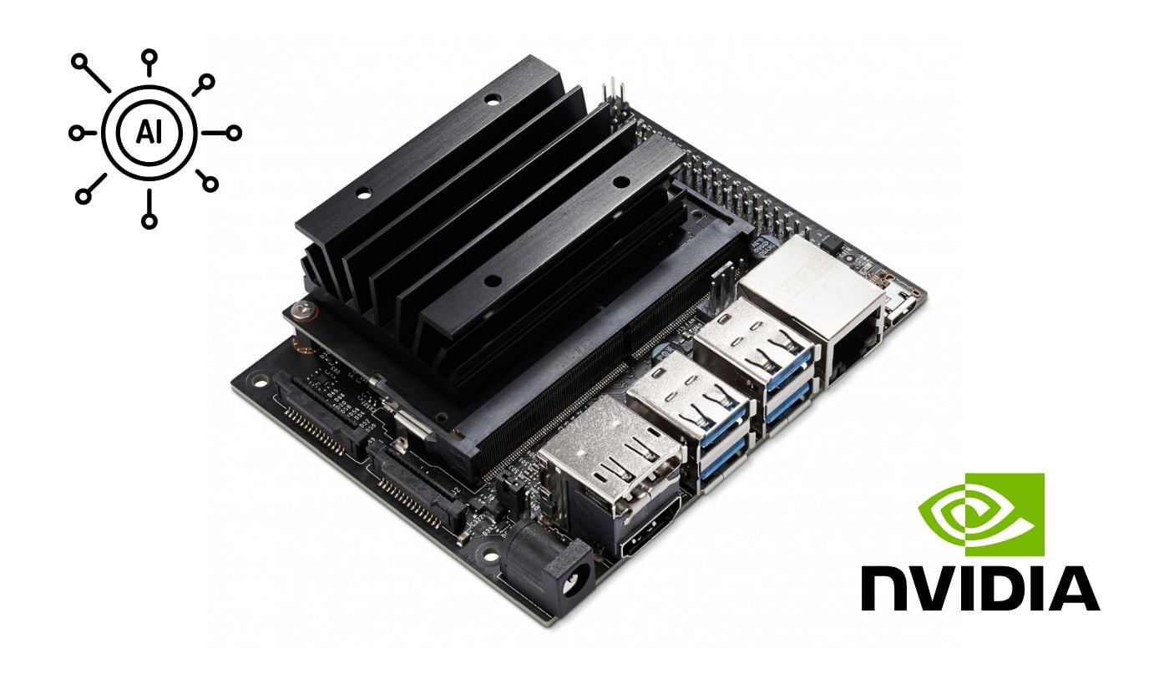
03 Implementation: Edge Device
NVIDIA Jetson Nano
GPU: Maxwell Architecture with 128 CUDA Cores
CPU: Quad-core ARM Cortex-A57 CPU
Memory: 4 GB 64-bit LPDDR4
Computing Power: 472 GFLOPS (FLOP per second)
Supports CUDA Programming and various deep learning frameworks
Used in Robotics, IoT Edge Devices, Prototyping
Cost: $129/unit
17
Notes:
The Deep Learning Hardware device that is used in this project is NVIDIA Jetson Nano.
<read slides>
Relatively affordable for IOT applications.

Slide 18
03 Implementation: Workflow
18
Notes:
Next part is how I implement the profiler

Slide 19

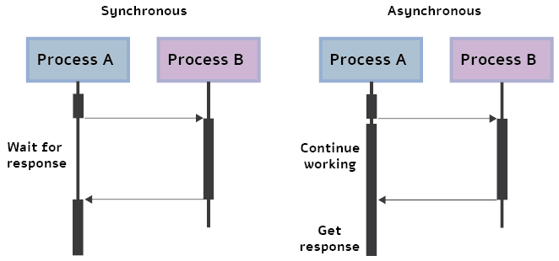
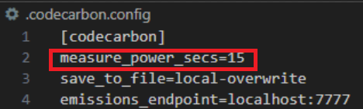
03 Implementation: Profiler
Cross Device Tool
Implemented hardware specific utility tool such as Nvidia Management Library NVML
Supports Scheduler to measure power usage periodically
Inference Time
Memory Footprint
Reserved Memory: PyTorch caching memory allocator reserve memory before actual inference
Allocated Memory: Actual memory allocated during the inference
GPU supports asynchronous execution.
Synchronization is required to facilitate correct inference measure
Power Usage
19
Notes:
When measuring inference time, the execution nature of GPU were carefully considered
<read1st line>. i.e: process A can execute without waiting other process to complete.
So, in parallel execution of DNN, many components are executed in parallel on GPU and profiler runs as different process and may not wait for all components to be completed if there is no synchronization between process.
This is one of the important implementation.
2ndly, when measuring memory footprint, Pytorch has caching memory allocator that reserve memory before actual inference to facilitate fast memory allocation.
As shown in the figure, the reserved memory is far larger than actual allocated memory. So that, getting how much memory is reserved can give insight the maximum memory required.
Lastly, Codecarbon is a cross device tool implemented hardware specific utility tool such NVML that measure power consumption on GPU.
<read 2ndline>
References:
https://deci.ai/blog/measure-inference-time-deep-neural-networks/

Slide 20

03 Implementation: Profiler
20
Notes:
References:
https://deci.ai/blog/measure-inference-time-deep-neural-networks/

Slide 21
03 Implementation: Workflow
21

Slide 22
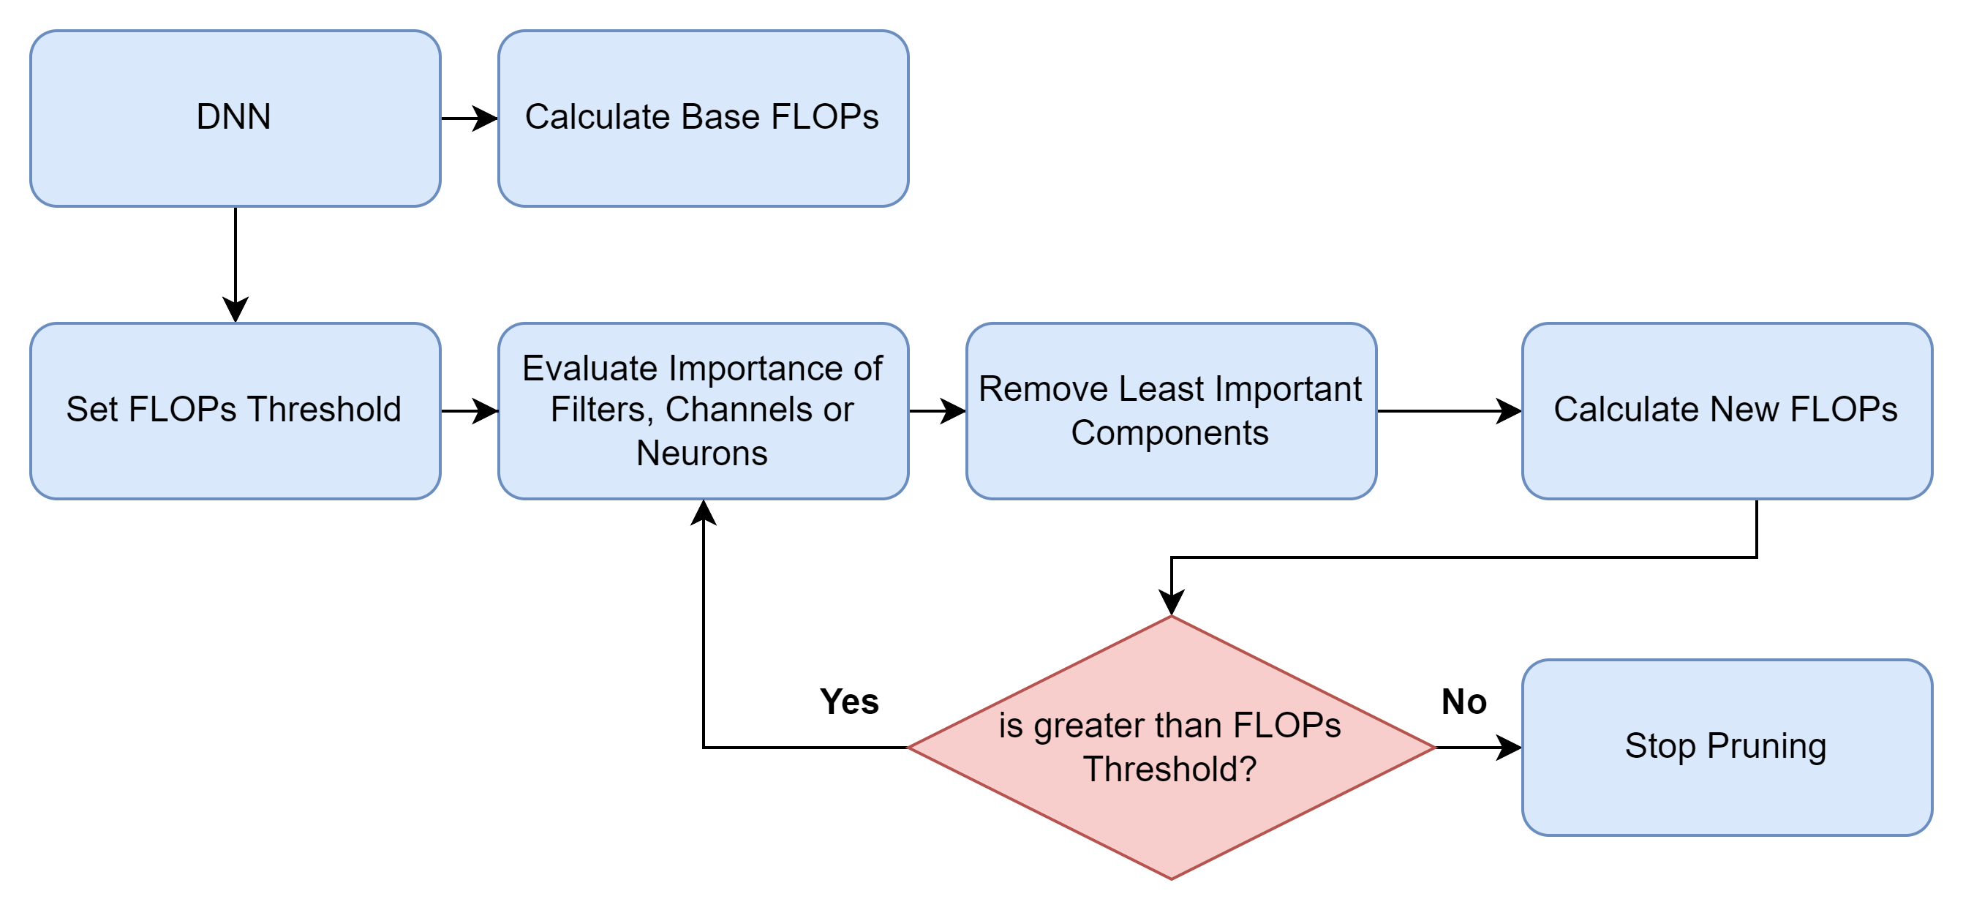
03 Implementation: Model Compression
How much the model should be pruned?
Computational Complexity ∝ Inference Time, Memory, Power Usage
Technique: Computational complexity-based pruning
22
Notes:
In this project, computational complexity-based pruning method combined with DepGraph algorithm was implemented.
Because computational complexity is directly propotional to inference time, memory and power usage.
And that’s why It’s efficient to reduce resource requirements by fine tuning computational complexit.

Slide 23
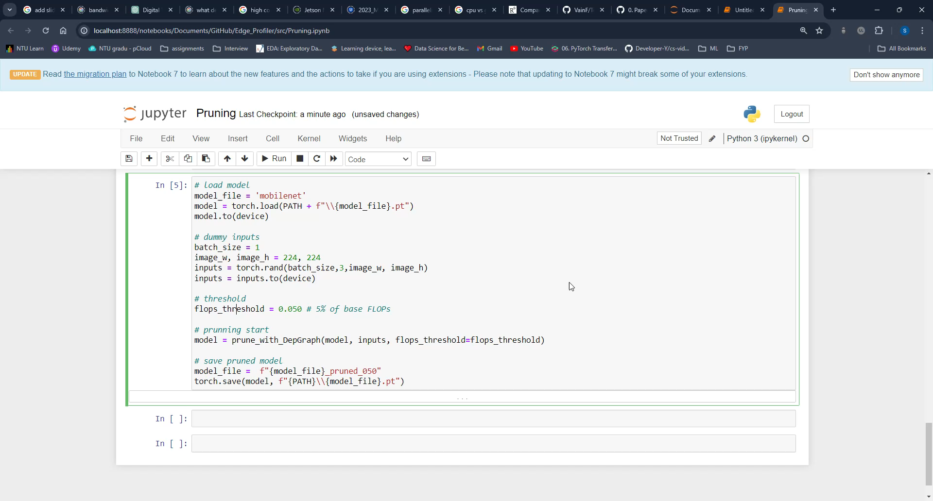
03 Implementation: Model Compression
23

Slide 24
04 Experiments
24

Slide 25
04 Experiments: Hyperparameter Settings
Computational Complexity (FLOPs): Base, 2.7% of Base, 5.2% of Base
Input Size (height x width): (224, 224), (192, 192), (160, 160), (112, 112)
Batch Size (images): 1, 8, 16, 32, 64, 128
Model Architecture: VGG16
Default Image Color Channels (RBG): 3
Default Number of Batches: 100
25
Notes:
In the experiment, the following Hyperparameter settings are considered.
The ratio of computational complexity to be pruned
<readslides>
VGG16 is one of the pretrained DNN used for image recognition, and it’s selected for the experiment demo.
<readslides>
I chose 100 batches to obtain more accurate measurement because the measurement such as inference time, energy can change slightly over time due to the nature of hardware processors.

Slide 26
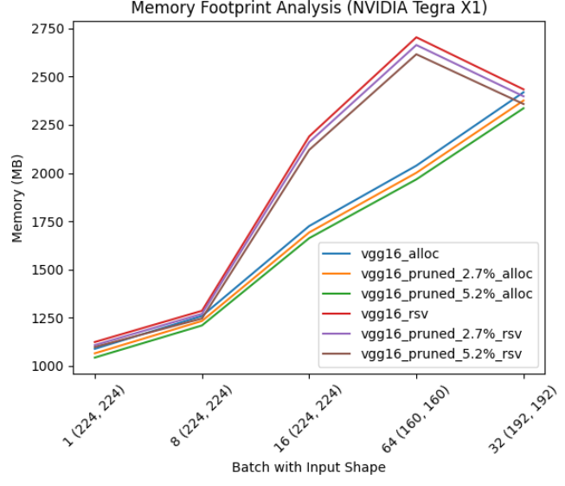
03 Experiments: Memory Footprint
Memory ceiling = ~2.8GB
26
Notes:
I compressed 3-dimensional space to 2 dimensional space i.e: batch size with input shape on X axis and Memory consumption (MB) on Y Axis.
As we see here on X axis, input size changes to smaller resolution as batch size becomes larger, it’s because the large batch size with large input is no longer fit in the memory.
At this point, input shape (224 x 224) is not fit the memory and switched to (160 x 160) resolution. So, we can roughly see that max memory that this device can facilitate is around 2.8GB.

Slide 27
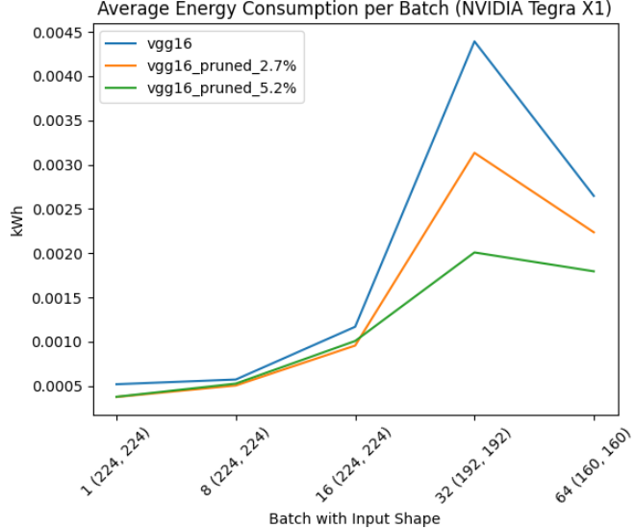
03 Experiments: Energy Consumption
Min energy user at all time = 5.2% of Base Pruned
27
Notes:
Energy consumption trend shows that DNN can maintain lowest energy less than 0.002 kWh for 5.2% of base pruned and VGG16 Base consumed the most energy.
In the aspect of energy consumption, 5.2% pruned model is relatively energy efficient.

Slide 28
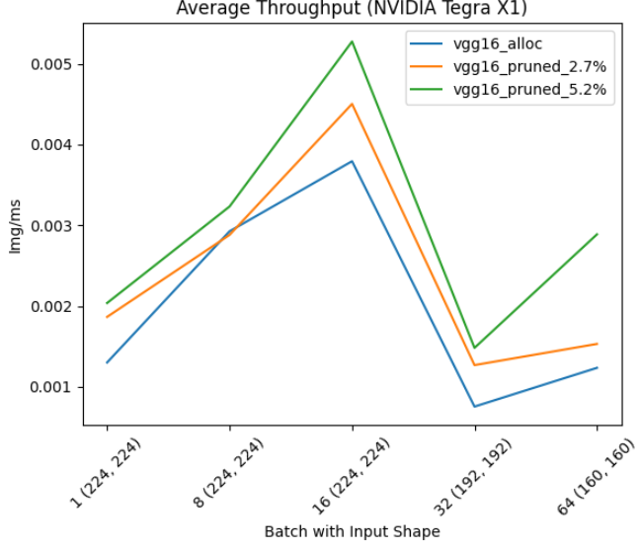
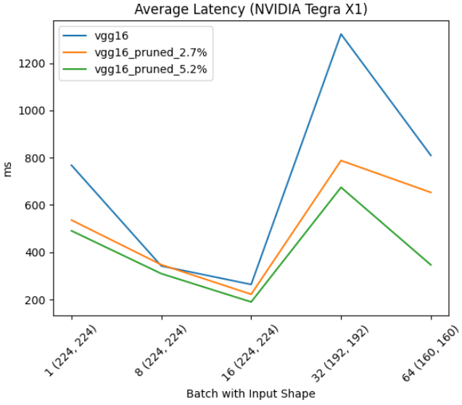
03 Experiments: Inference Speed
Maximum Throughput: 5.2% Base Pruned at 16(224, 224)
Minimum Latency: 5.2% Base Pruned at 16(224,224)
28
Notes:
As observed here, Maximum throughput and minimum latency is achieved by 5.2 % based pruned model at 16 batch size and (224, 224) image size.
But does it mean 5.2% pruned is the best? Actually, it’s not.

Slide 29
03 Experiments: Observation
Tradeoff: accuracy vs resource requirements.
29
Notes:
We have to think of the tradeoff between the accuracy and resource requirements.
As we expected base model is always better at accuracy, but 5.2% and 2.7% pruned model actually achieved performance closed to base model at 224 x 224 image size.
So, 5.2% pruned model is relatively concluded suitable for this particular device to minimize resource requirements.

Slide 30
05 conclusion & Future works
30
Notes:
Finally, let me conclude this project by summarizing and presenting extended works.

Slide 31

05 Conclusion & Future Works: Conclusion
Provides insight of resource limitations and requirements
Structural complexity-based pruning minimizes resource utilization
Ease of determining tradeoff between performance and resource
31
Notes:
This project helps to gain insight of resource limitations of the device and requirements of DNN.
Structural complexity-based pruning relatively minimizes resource requirement without sacrifing much performance
So that, user can gain insight easily to determine tradeoff between model performance and resource requirements

Slide 32
05 Conclusion & Future Works: Future Works
Multi Deep Learning Frameworks Support
Edge Devices Virtualization Support such Docker Systems
Hardware Oriented Pruning
32
Notes:
Finally, this project can be extened to use multi deep learning framworks supports such as TensorFlow.
And Edge device virtualization support such as Docker Systems can be considered to be extended, so that, user can gain insight without buying actual deep learning hardware.
Last but not the least, using Virtualizaton support, hardware oriented pruning can be also extended such that model can be pruned based on specific performance metric such inference time and energy used.

Slide 33
Thank you
33
Notes:
That is the end of my presentation.
Thank you for your time. Any question?

Slide 34

01 Introduction: Background
Cloud
Deep Neural Networks (DNN)
DNN
DNN
Cloud
Layer
Neuron
Cloud Computing
Computation takes place here
DNN
Edge Computing
So slow..
Computation takes place here
Edge Devices
Edge Devices
5
Notes:
Deep Neural Network is a subset of machine learning algorithms inspired by the structure and function of human brains.
It consists of interconnected nodes called neurons, organized in layers. Each layer processes information, passes it to the next layer to learn the complex patterns in data.
Eventually, the network can solve the specific task using the given data.
In today world, DNNs are widely used in image processing such recognizing images and object detection.
DNN requires high computational power to use due to its complex structure.
In practice, It’s usually deployed on systems equipped with high computational resources such as cloud servers. So that, DNN can process the data in a short time. This is called cloud computing.
However, cloud computing comes with several drawbacks such as data bandwidth latency, i.e.: slow response and data transfer from the cloud which is a nightmare for the real-time Edge applications such as autonomous cars..
To overcome such problems, industries try to infer DNN on edge devices with minimal dependencies on cloud computing power.

Slide 35
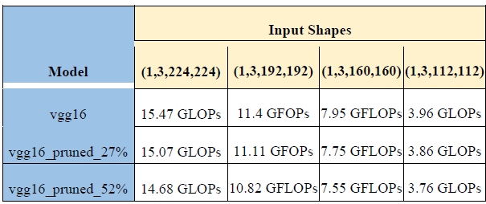
03 Experiments: Base FLOPs

